Slide 1



Java basics
Session
1
Chaim Turkel
Ido Barash

Slide 2


Course introduction
Part 1 : Java basics
Part 2 : Java advanced

Slide 3
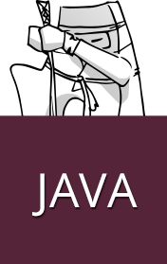
Part 1: Java basics
JVM and basic syntax
Java inheritance
Collections, Generics, Reflection and annotations

Slide 4
Part 2: Java advanced
JEE
Maven
Spring
JUnit
Web-services
Hibernate

Slide 5
Java basics
Introduction
The JVM
Java simple class
Variables
Conditions
Loops
Methods
Enumerations
Javadocs & Comments

Slide 6
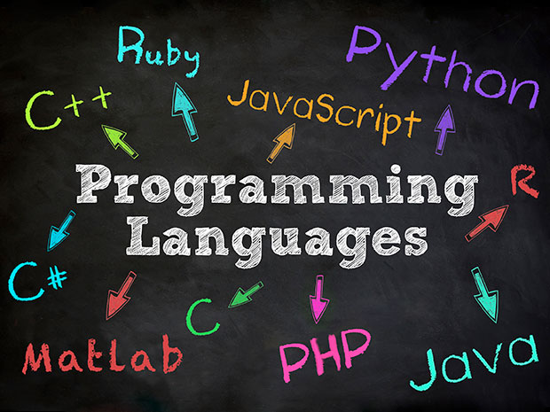
Java introduction
Java is a type of coffee (Indonesian)
Java is a High level programming language.
Released in 1995 by Sun Microsystems.
Now owned by the mighty Oracle.
Java is:
Simple
Object Oriented
Secure
Portable
Multithreaded
Free

Slide 7
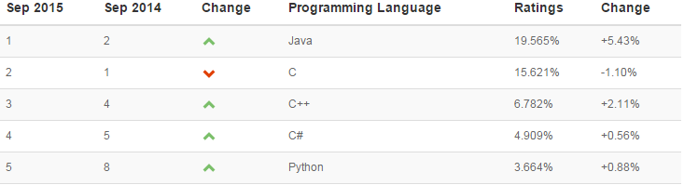
Java introduction
Java is the 1/2nd most popular programming language
Java is the 1st most popular among the high level languages.
Java is used everywhere:
97% of enterprise desktops
3 billion mobile phones
#1 choice for robust enterprise applications.
Google choice (android, GWT, etc..)
Large and reach community

Slide 8
Java Virtual Machine
Masks the operating system
Interprets the bytecode to actions or operating system calls on runtime (jus-in-time compilation)
Handles memory allocation and deacllocation:
STACK for method calls
HEAP for objects
Garbage collection (background thread)
Java: System.out.println("Hello world!");
Bytecode:
0 getstatic #6 <Field java.lang.System.out Ljava/io/PrintStream;>
3 ldc #1 <String "Hello world!">
5 invokevirtual #7 <Method java.io.PrintStream.println(Ljava/lang/String;)V>
8 return

Slide 9






Java Virtual Machine (JVM)
Platform independent - “Write once, run anywhere”
Java source file (.java)
Java Compiler
Java Bytecode (.class)
Network
JVM Linux
JVM Web-browser
JVM Windows

Slide 10
JVM ,JDK & JRE
JVM – Java virtual machine. Enough to interpret Java .class files.
JRE – Java Runtime Environment Contains an implementation of the JVM + utilities like Math, Lang and runtime libraries)
JDK – Java Development Kit Contains JRE (or JREs) and several development tools. Javac, profiling tools, etc…

Slide 11
JVM - questions
Is JVM a compiler or an interpreter?
What is the difference between a JRE and a JVM?
What gives java it’s “write once and run anywhere” nature?

Slide 12
JVM - questions
Interperter – code is already compiled to bytecode using javac command
Is JVM a compiler or an interpreter?
What is the difference between a JRE and a JVM?
What gives java it’s “write once and run anywhere” nature?

Slide 13
JVM - questions
Interperter – code is already compiled to bytecode using javac command
Is JVM a compiler or an interpreter?
What is the difference between a JRE and a JVM?
What gives java it’s “write once and run anywhere” nature?
JRE contains an implementation of a JVM + several utilites such as Math, Lang etc..

Slide 14
JVM - questions
Interperter – code is already compiled to bytecode using javac command
Is JVM a compiler or an interpreter?
What is the difference between a JRE and a JVM?
What gives java it’s “write once and run anywhere” nature?
JRE contains an implementation of a JVM + several utilites such as Math, Lang etc..
The code is compiled to bytecode which is interpreted by platform specific JVMs. Each OS or device has it’s own JVM.

Slide 15
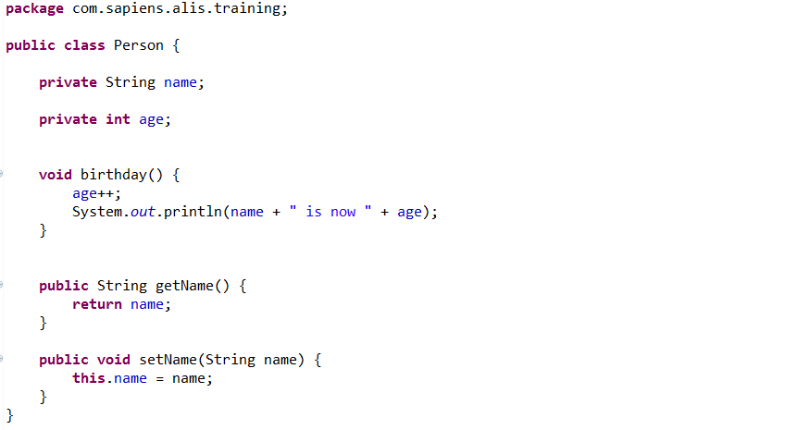
Simple Java class
Package
Members
Method
Getter method
Setter method

Slide 16


Java class - Constructors
Constructor – a special method which creates a new instance.
Every class has a constructor. If no constructor was specified, an empty constructor will be provided.
Empty constructor:
Parameters constructor (initiate fields):
A constructor can be private and accessed within the class.

Slide 17
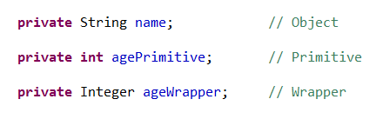
Variables
Java is type safe.
Primitive data types: int, double, short, long…
Objects and references
Wrappers (Object): Integer, Double, Short, Long

Slide 18
Variables
Primitive types variables can be set “straight forward”
Objects are created by the word “new”
Data types wrappers can be created either way

Slide 19
Variables - Strings
Strings are Objects
Strings can be initiated by “new” or by literal.
new() - creates the string in the heap.
Literal – Creates the String in the string-pool (special area in the heap which allows strings to be reused).

Slide 20
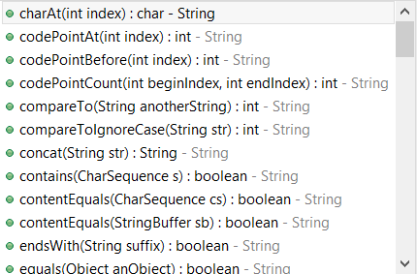
Variables - Strings
Strings are immutable – any change creates a new String in the heap.
String objects comes with plenty of manipulation methods:

Slide 21

Variables - Arrays
Array is a data-structure which stores a fixed size collection of elements of the same type.
Arrays are objects.

Slide 22
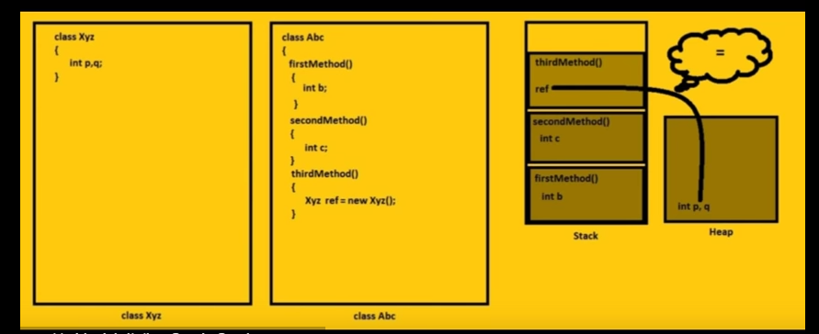
Stack / Heap

Slide 23
Variables - Questions
What would you use to compare two String variables : ­ the operator == or the method equals()?
What is the difference between creating String as new () and literal?

Slide 24
Variables - Questions
Equals() to compare values. Using the == operator will check if two references points to the same String.
What would you use to compare two String variables : ­ the operator == or the method equals()?
What is the difference between creating String as new () and literal?

Slide 25
Variables - Questions
Equals() to compare values. Using the == operator will check if two references points to the same String.
What would you use to compare two String variables : ­ the operator == or the method equals()?
What is the difference between creating String as new () and literal?
A string which was created with new() will be created in the heap like any normal Java object.
A string which was created using literal will be created using the string-pool.

Slide 26
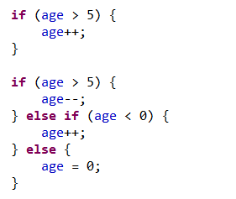
Conditions
if – else

Slide 27

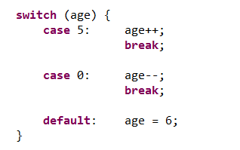
Conditions
if – else : terenary ( a > b ) ? True : false
switch-case

Slide 28




Loops
While
For
For each

Slide 29

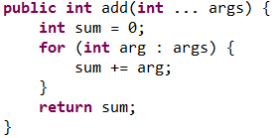
Methods
Modeifier returnedValueType methodName ( parameters ) {
body
}
Void – no returned value:
With returned value and multiple parameters:
Parameters are always passes by value

Slide 30
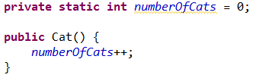

Static
An Object or a Method which belong to the class itself and not to the specific instance.
Each instance of a cat that will be created will increase the general number of cats.
A static method can only access static members.

Slide 31
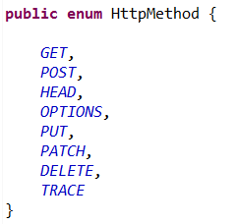

Enumeration - simple

Slide 32
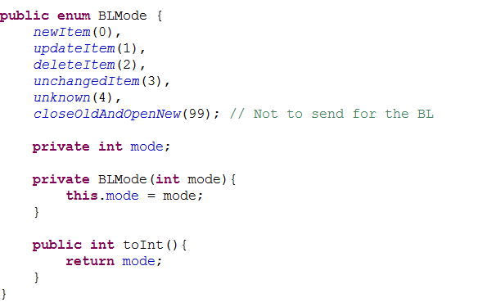
Enumeration - Complex

Slide 33
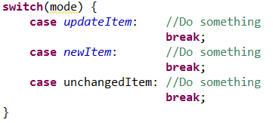
Enumeration - Switch
A simple way to use enumerations is to declare behavior with switch-case.

Slide 34


Comments
Java offers C++ like comments:
Single line:
Block:

Slide 35
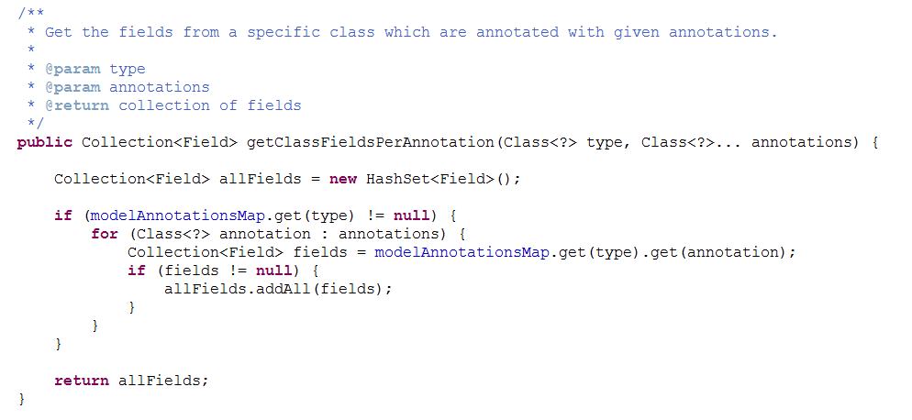
Javadocs
Documentation generator from Java source code.

Slide 36
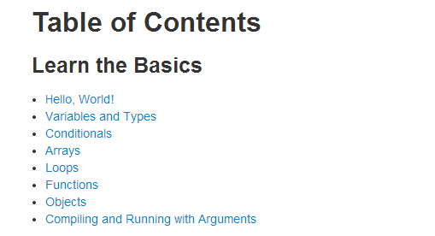
Exercise
http://www.learnjavaonline.org/

Slide 37
Next session
Inheritance
Inner classes
Interfaces
Polymorphism
And more…
Session
2

Slide 38

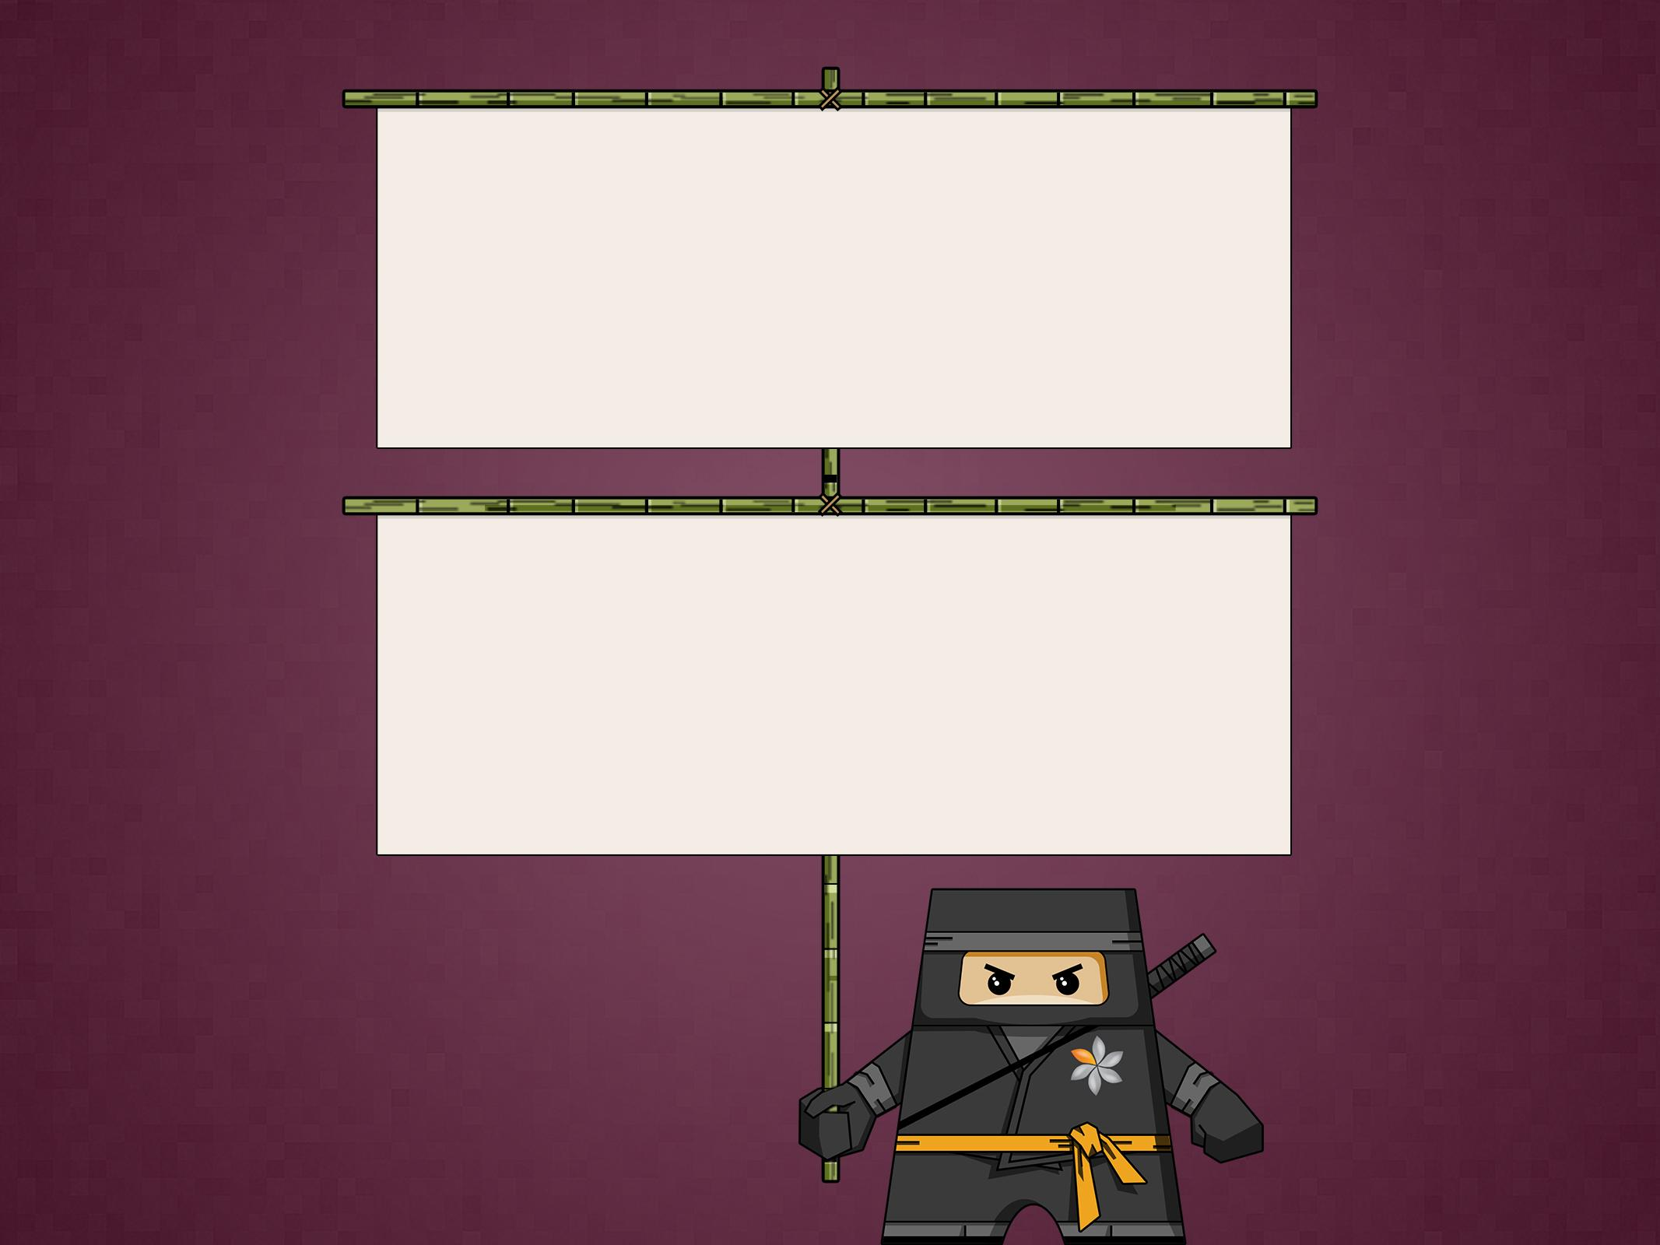
THANK YOU
Chaim Turkel
Email: chaim@tikalk.com

